Slide 1
Project Management 项目管理
Lecture 5
Ruzanna Chitchyan, Jon Bird, Pete Bennett
TAs: Alex Elwood, Alex Cockrean, Casper Wang
(Using materials created by N. Walkinshaw and R. Craggs)
Notes:
RC

Slide 2
Overview
About Measurement
Measurement under White Box:
Lines of code
Cyclomatic Complexity
Measurement under Black Box:
Planning Poker
Software Laws:
Patents, Copyright, Contract, Privacy
关于测量
白盒下的测量：
- 代码行数
- 圈复杂度
黑盒下的测量：
- 计划扑克
软件法律：
- 专利、版权、合同、隐私
Notes:
Introduce the objectives for the module.
关于测量
白盒下的测量：
- 代码行数
- 圈复杂度
黑盒下的测量：
- 计划扑克
软件法律：
- 专利、版权、合同、隐私

Slide 3
Measurement is Central to Quality
How to plan for the project time and effort?
For the team?
For the customer?
Which software/part of it needs more time for testing?
Which developer should get a bonus payment for productivity?....
“You cannot control what you cannot measure.”
Tom DeMarco, 1982
Notes:
如何规划项目的时间和精力？
针对团队？
针对客户？
哪些软件/其中的哪些部分需要更多的时间进行测试？
哪位开发人员应该因为生产力而获得奖金支付？

Slide 4
What is “Measurement”?
Attributing values to objects.
The fuel efficiency of a car (gallons per mile)
The number of goals scored by a footballer
The cost of a house
Can use these values as basis for comparison
What is the cheapest house?
Who is the best goal scorer?
Can use these measurements and comparisons to make better decisions.
Which car should I buy (e.g., given five candidate cars)
Which striker should I put in my team?
Notes:
对对象进行价值归因。
汽车的燃油效率（每英里加仑数）
足球运动员进球数
房屋的成本
可以将这些值作为比较的基础。
哪个房子最便宜？
谁是最佳射手？
可以利用这些测量和比较来做出更好的决策。
我应该买哪辆车（例如，考虑到五辆候选车）？
我应该在我的团队中选择哪个前锋？

Slide 5
Measurement is Difficult in Software Engineering
Most entities are difficult to measure reliably
Difficult or impossible to “pin down” a single value
E.g., Software Quality (ISO/IEC 25010):
Notes:
大多数实体很难可靠地衡量。很难或者不可能“确定”一个单一的值。例如，软件质量（ISO/IEC 25010）：

Slide 6
Usual Metrics: Size and Complexity
After development ...
How much effort will it require for maintenance?
Where should we direct testing effort?
How much effort was required for development?
Metrics are based upon source code (“white box”)
Before development has started ...
How much programming effort will module X require?
What will be the estimated cost of the final product?
Metrics are based upon requirements / specification (“black box”)
Notes:
经过开发。。。
它需要多少维护工作量？
我们应该在哪里指导测试工作？
发展需要付出多少努力？
度量基于源代码（“白盒”）
在开发开始之前。。。
模块X需要多少编程工作量？
最终产品的预计成本是多少？
指标基于需求/规范（“黑匣子”）

Slide 7
White Box Complexity Metrics

Slide 8
Number of lines in a file (or a group of files)
Easy to compute
Easy to understand and interpret
Often sufficient for an approximate measure of size
Widely used (perhaps the most widely used) metric
Comments
What is a line?
Blank lines
Not all “lines” are equal
Ignores logical/ architectural complexity
Highly language-specific
Notes:
易于计算
易于理解和解释
通常足以近似测量尺寸
广泛使用（也许是最广泛使用）的度量
评论
什么是线？
空行
并非所有的“线”都相等
忽略逻辑/体系结构复杂性
高度针对语言

Slide 9
Example: Who is the most productive programmer?
Measured in lines of code

Slide 10
Example: Who is the most productive programmer?
Measured in lines of code
Designed entire
system. Wrote
highly efficient
algorithmic core.
Copied and pasted license text into every source file.

Slide 11
Cyclomatic Complexity
Calculated from the control flow graph:
V(G) = E – N + 2P
E – number of edges;
N – number of nodes;
P – number of procedures (usually 1)
Number of independent paths through the code
Independent path – any path that introduces at least one new statement/condition
Notes:
根据控制流程图计算：
V（G）=E–N+2P
E——边数；
N——节点数；
P–程序数（通常为1）
通过代码的独立路径数
独立路径–引入至少一个新语句/条件的任何路径

Slide 12







Number of Edges = 27
Number of Nodes = 22
V = 27 – 22 + 2 = 7
Triangle Example

Slide 13
Black Box Complexity Merics

Slide 14
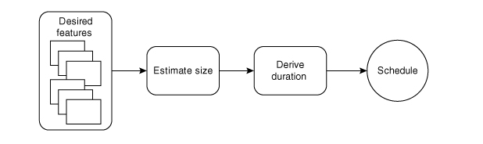
Estimating Agile Projects
Figure from: Agile Estimating and Planning by Mike Cohn

Slide 15
Storey Points (Size Estimation)
An informal, agile unit of “size measurement”
Usually an estimate from 1-10
Derive an estimate from the whole team at sprint planning meetings
Based on the idea of the “Wisdom of the Crowds”
The collective estimate of groups (i.e., of effort required for a story) is better than the estimate of an individual
Notes:
一种非正式、灵活的“尺寸测量”单位
通常为1-10的估计值
在sprint规划会议上从整个团队得出估计
基于“众之智慧”的理念
群体的集体估计（即故事所需的努力）比个人的估计要好

Slide 16
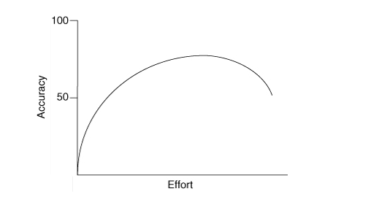
Accuracy vs Effort in Project Estimation
Figure from: Agile Estimating and Planning by Mike Cohn

Slide 17
Planning Poker
The whole team is involved
Each member is given a set of numbered cards
Numbers follow the Fibonacci sequence
1,3,5,8,13,20,...
Larger tasks become harder to estimate in exact terms
Low values - trivial to implement
High values - difficult to implement
Each member is also given a “?” card
Notes:
整个团队都参与其中
每个成员都有一套编号的卡片
数字遵循Fibonacci序列
1,3,5,8,13,20,...
更大的任务变得更难准确估计
低值-实现起来微不足道
高价值-难以实施
每位会员还将获得一张“？”卡

Slide 18
Planning Poker: Process

Slide 19
Planning Poker: Process
“I think it’s difficult because …”

Slide 20
Planning Poker: Process
Cycle repeats for a maximum of 3 iterations (to avoid infinite loops!)

Slide 21
Team Velocity
Number of (estimated) story points implemented per sprint.
Can be derived from previous sprints.
e.g., Average points implemented from previous x sprints.
Can be used to estimate:
Time required to complete project.
Target number of stories that can be completed in a sprint.
Notes:
每个sprint实现的（估计的）故事点的数量。
可以从以前的sprint中派生。
例如，从之前的x个sprint中实现的平均点。
可用于估计：
完成项目所需的时间。
冲刺中可以完成的故事的目标数量。

Slide 22
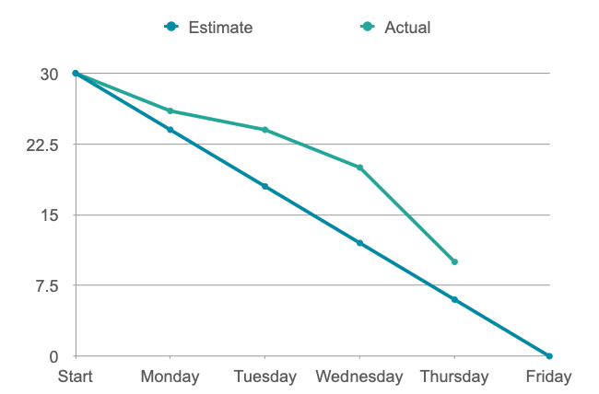
Burn Charts

Slide 23
Software Laws: Patents, Copyright, Contract, Privacy

Slide 24
Patent Law
A government license giving a right for a set period, especially to exclude others from making, using, or selling an invention
Granted by the government
to stop others exploiting your invention
Lasts 20 Year
Inventions Must
be new
be an inventive step (not an obvious improvement)
capable of industrial application
Notes:
一种政府许可证，赋予一定期限的权利，尤指禁止他人制造、使用或销售一项发明
政府授予
阻止别人利用你的发明
持续20年
发明必须
是新的
是一个创造性的步骤（不是明显的改进）
具有工业应用能力

Slide 25
The “Social Network”
Did Mark Zuckerberg infringe a patent?
No patent was granted
The idea was not new, social networks existed before this

Slide 26
Copyright
Creator has exclusive rights to perform, copy, adapt their work.
Everyone else must get Permission (and possibly pay)
"literary, dramatic, musical and artistic works" includes software
Automatically owned (not granted)
Lasts 70 years after authors death (lots of exceptions)
This affects software in 2 different ways:
Illegal Copies of Applications (Piracy) !
Using someone else's code/UI design/etc. in your application
(Not the "idea" but the actual "stuff" (code, design, documents) created by someone else)
Notes:
创作者拥有执行、复制和改编其作品的独家权利
其他所有人都必须获得许可（并可能付费）
“文学、戏剧、音乐和艺术作品”包括软件
自动拥有（未授予）
作者去世后持续70年（很多例外）
这会以两种不同的方式影响软件：
非法复制应用程序（盗版）！
在您的应用程序中使用他人的代码/UI设计等
（不是“想法”，而是其他人创建的实际“东西”（代码、设计、文档））

Slide 27
Copyright Theft?
NO:
Get permission (obtain a licence)
Be within "fair use" (e.g. for study or review)
Use "open source" software
Create something similar yourself, independently
"Obvious" code can't be copywrited
YES:
Displaying an image from another page
Using code found on the internet
Copying Windows 95 for your friends
Notes:
不：
获得许可（获得许可证）
在“合理使用”范围内（例如用于研究或审查）
使用“开源”软件
自己独立创造类似的东西
无法复制“明显”的代码
对：
显示另一页中的图像
使用互联网上的代码
为您的朋友复制Windows 95

Slide 28
The “Social Network”
Did Mark Zuckerberg infringe copyright?
Maybe
but there is no evidence he copied
it it's not fair use
it wasn't OSS
he saw the code so didn't invent it himself

Slide 29
Contract Law
Employer contracts usually force an employee to:
Not work for anyone else
Hand over any ideas (Intellectual Property)
Not disclose company secrets (Non-disclosure-agreements)
(even after you stop working for them)
Notes:
雇主合同通常迫使雇员：
不为其他人工作
移交任何想法（知识产权）
不披露公司秘密（保密协议）
（即使在你停止为他们工作之后）

Slide 30
The “Social Network”
Did Mark Zuckerberg break contract?
Probably Not
there was no written contract
he did not disclose any secrets about the other project

Slide 31
Data Protection
8 Principles of Data Protection:
Any company storing "personal data" must make sure it is:
fairly and lawfully processed (consent, contractual and legal obligations, public interest, ...)
processed for limited purposes;
adequate, relevant and not excessive;
accurate and, where necessary, kept up to date;
not kept longer than necessary;
processed in accordance with the data subject's rights;
secure; not transferred to countries without adequate protection
UK : Data Protection Act
EU : Data Protection Directive
US : a "patchwork" of state and national laws
Notes:
8数据保护原则：
任何存储“个人数据”的公司都必须确保：
公平合法地处理（同意、合同和法律义务、公共利益等）
为有限目的处理；
充分、相关且不过分；
准确，必要时保持最新；
保存时间不超过必要时间；
根据数据主体的权利进行处理；
保护未转移到没有充分保护的国家

Slide 32
Review
How can we measure complexity?
Why do we use black box options?
What is a patent
What is the difference between patent and copyright?
What do we learn about contract from Social Network?
Notes:
A. System behavior is how a system acts and reacts. It is an outwardly visible and testable activity of a system.
B. A use-case model describes a system’s functional requirements in terms of use cases. It is used to communicate with the end users and the domain experts. A benefit includes buy-in at an early stage of system development.
C. An actor is anything that exchanges data with the system and is external to the system. A use case is a sequence of actions a system performs that yields an observable result of value to a particular actor.
D. An activity diagram in the use-case model can be used to capture the activities in a use case. It is essentially a flow chart, showing flow of control from activity to activity.
1. 我们如何衡量复杂性？
复杂性可以通过多种方式来衡量，包括代码行数、算法复杂度、问题的范围和变化等因素。
2. 为什么我们使用黑盒选项？
我们使用黑盒选项是因为它们提供了一种简单的方式来处理复杂性，而无需了解内部的具体实现细节。这对于简化问题、提高效率和保护知识产权都是有利的。
3. 什么是专利？
专利是政府授予的一种权利，赋予发明人在一定时间内独占性的权利，以防止他人制造、使用或销售该发明。
4. 专利和版权之间有什么区别？
专利主要用于保护发明或创新性的产品、方法或流程，而版权主要用于保护原创的文学、艺术和音乐作品。专利提供了对发明的独占权，而版权提供了对作品的独占权。
5. 从社交网络中我们学到了什么有关合同？
从社交网络中我们学到了合同的重要性和约束力。合同可以确保各方之间的权利和责任得到明确界定，从而有效地管理商业关系并防止纠纷的发生。

